Slide 1
Transforming the EER diagram into relations
The steps:
Map regular entities
Map weak entities
Map multivalued attributes
Map binary relationships
Map associative entities
Map unary relationships
Map ternary relationships
Map supertype/subtype relationships(gen/specialization)

Slide 2
Transforming E-R diagrams into relations
Mapping regular entities to relations
  Composite attributes: use only their simple, component attributes

Slide 3

Mapping a composite attribute

Slide 4
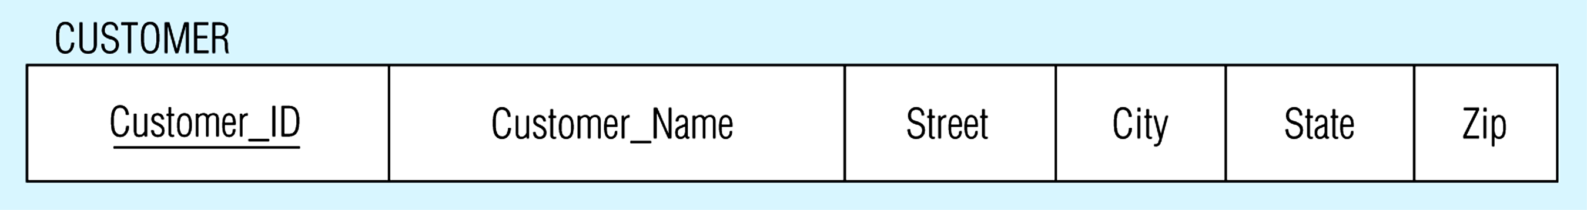
Looks like this using relational schema notation

Slide 5
Transforming E-R diagrams into relations
Mapping weak entities
  Becomes a separate relation with a foreign key taken from the superior entity

Slide 6
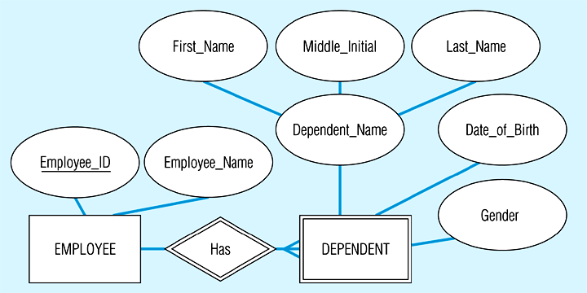
Example of mapping a weak entity

Slide 7
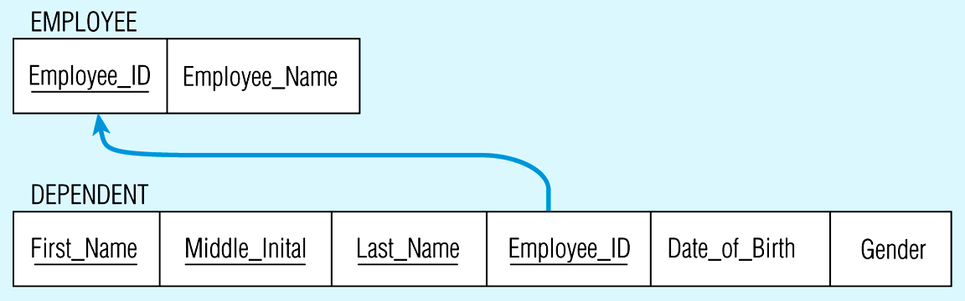
Looks like this using relational schema notation

Slide 8
  Transforming E-R diagrams into relations
  Mapping Multivalued attributes
  Multi-valued attributes: become a separate relation with a foreign key taken from the superior entity

Slide 9
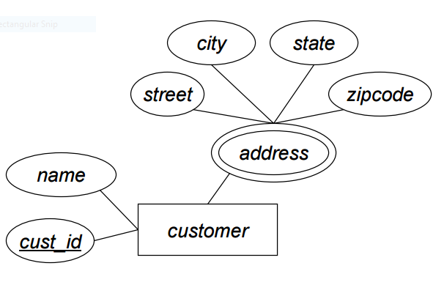
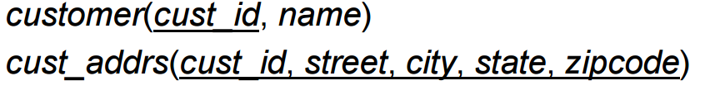
Example of mapping a multivalued entity
Relational schema

Slide 10
Transforming E-R diagrams into relations
Mapping binary relationships
  One-to-many - primary key on the one side becomes a foreign key on the many side
  Many-to-many - create a new relation (associative entity) with the primary keys of the two entities as its primary key
    call these intersection entities to distinguish them from associative entities created at the conceptual level
  One-to-one - primary key on the mandatory side becomes a foreign key on the optional side

Slide 11
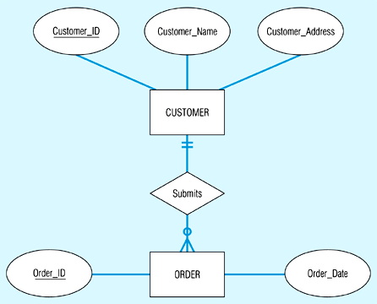
Example of mapping a 1:M relationship

Slide 12
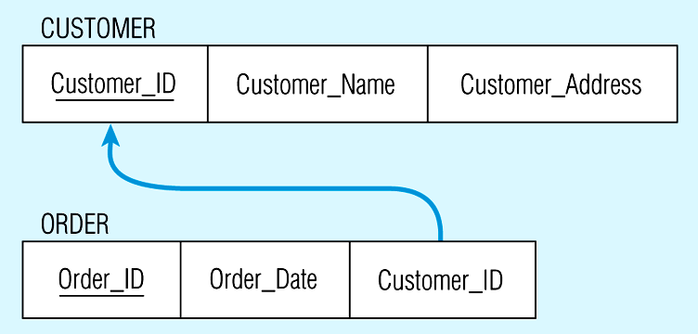
Looks like this using relational schema notation

Slide 13
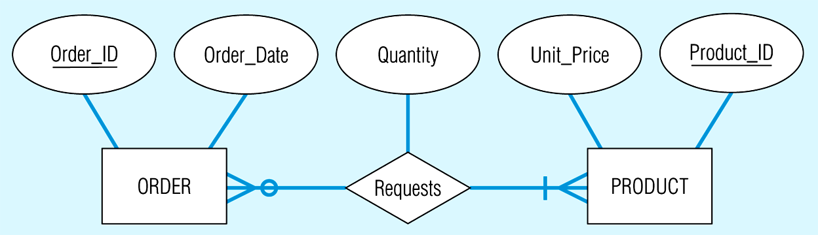
Example of mapping an M:M relationship

Slide 14
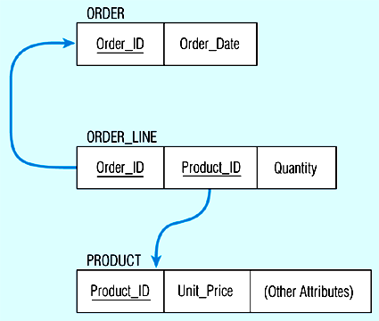
Looks like this using relational schema notation

Slide 15
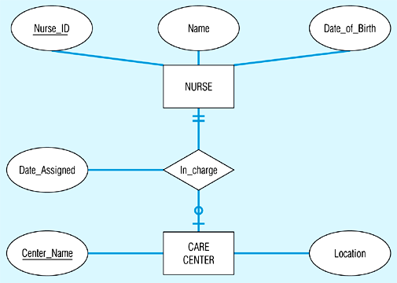
Mapping a binary 1:1 relationship

Slide 16
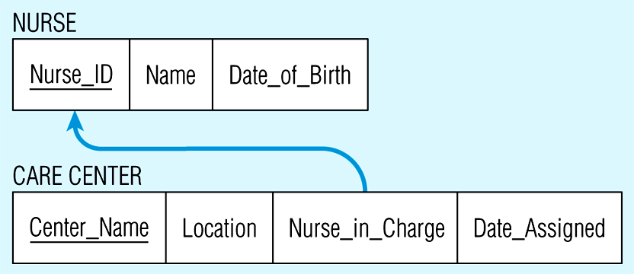
Looks like this using relational schema notation

Slide 17
Transforming E-R diagrams into relations
Mapping associative entities
  Identifier not assigned
    Default primary key for the association relation is the primary keys of the two entities
  Identifier assigned
    It is natural and familiar to end-users
    Default identifier may not be unique

Slide 18
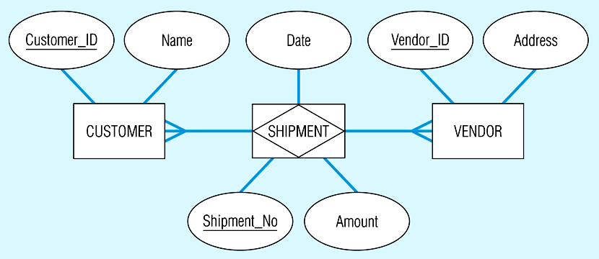
Mapping an associative entity with an identifier

Slide 19
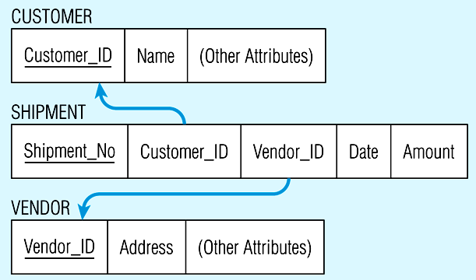
Looks like this using relational schema notation

Slide 20
Transforming E-R diagrams into relations
Mapping unary relationships
  One-to-many - recursive foreign key in the same relation
  Many-to-many - two relations:
    One for the entity type
    One for an associative relation in which the primary key has two attributes, both taken from the primary key of the entity

Slide 21
For example...
Emp_Num
Supervises
EMPLOYEE
Emp-Name
Emp_Address

Slide 22
Would look like...
references
Emp_Num Emp_Name Emp_Address Boss_Num

Slide 23
And..
Num_Units
Comp_Num
BOM
COMPONENT
Description
Unit_of-Measure

Slide 24
Would look like...
COMPONENT
Comp_Num Desc Unit_of_Measure
BOM
Num-of_Units Comp_Num Subassembly_Num

Slide 25
Transforming E-R diagrams into relations
Mapping ternary (and n-ary) relationships
  One relation for each entity and one for the associative entity

Slide 26
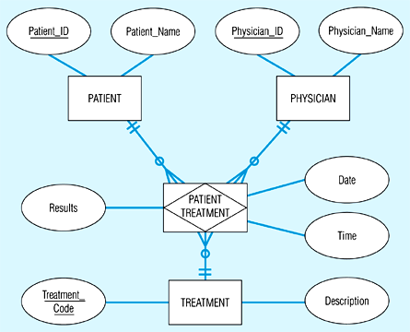
Mapping a ternary relationship

Slide 27
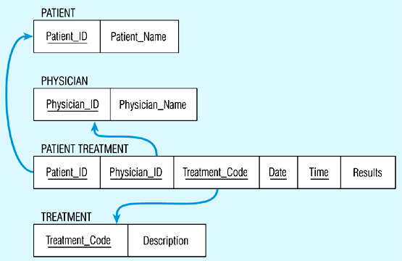
Looks like this using relational schema notation

Slide 28
Transforming E-R diagrams into relations
Mapping Supertype/subtype relationships
  Create a separate relation for the supertype and each of the subtypes
  Assign common attributes to supertype
  Assign primary key and unique attributes to each subtype
  Assign an attribute of the supertype to act as subtype discriminator

Slide 29
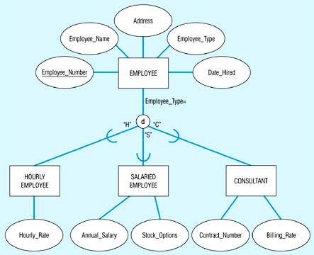
Mapping Supertype/subtype relationships

Slide 30
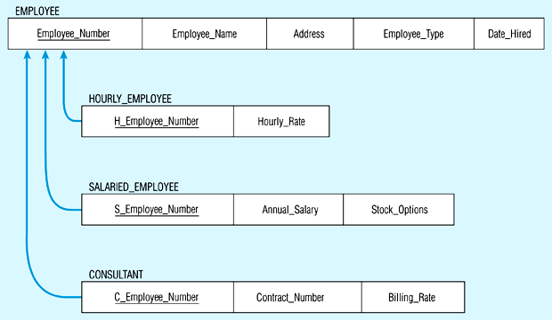
Would look like this...

Slide 31
Let’s try a couple….

Slide 32
Well-structured relations
Well-structured relations contain minimal redundancy and allow insertion, modification, and deletion without errors or inconsistencies
Anomalies are errors or inconsistencies resulting from redundancy
  Insertion anomaly
  Deletion anomaly
  Modification anomaly

Slide 33
Data normalization
Normalization is a formal process for deciding which attributes should be grouped together in a relation
  Objective: to validate and improve a logical design so that it satisfies certain constraints that avoid unnecessary duplication of data
  Definition: the process of decomposing relations with anomalies to produce smaller, well-structured relations

Slide 34
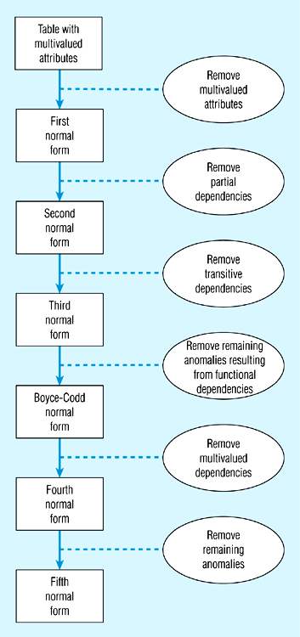
Steps in normalization

Slide 35
Functional dependencies and keys
Functional dependency: the value of one attribute (the determinant) determines the value of another attribute
  A -> B, for every valid instance of A, that value of A uniquely determines the value of B
Candidate key: an attribute or combination of attributes that uniquely identifies an instance
  Uniqueness: each non-key field is functionally dependent on every candidate key
  Non-redundancy

Slide 36
First normal form
No multi-valued attributes.
Every attribute value is atomic.

Slide 37
Second normal form
1NF and every non-key attribute is fully functionally dependent on the primary key.
Every non-key attribute must be defined by the entire key, not by only part of the key.
No partial functional dependencies.

Slide 38
Third normal form
2NF and no transitive dependencies (functional dependency between non-key attributes.)

Slide 39
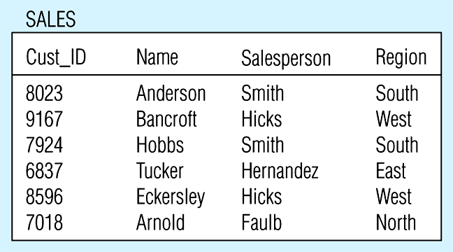
Relation with transitive dependency

Slide 40
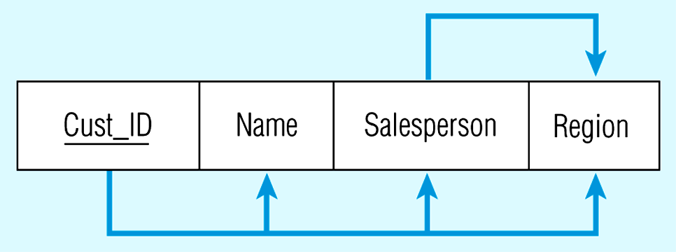
Transitive dependency in SALES relation

Slide 41
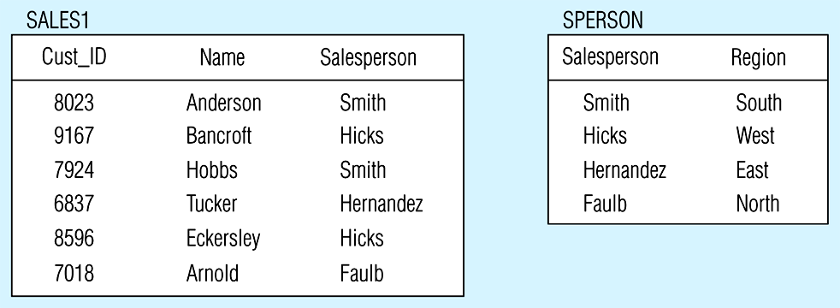
Removing a transitive dependency

Slide 42
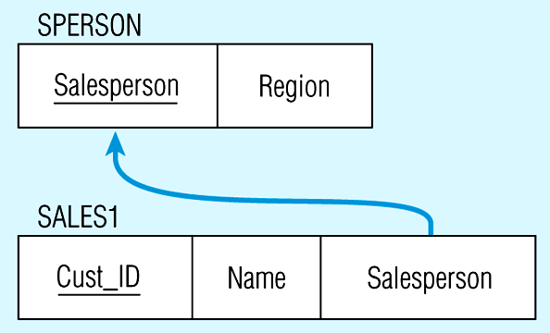
Relations in 3NF

Slide 43
Let’s practice...

Slide 44
Other considerations...
Synonyms: different names, same meaning.
Homonyms: same name, different meanings.

